Slide 1
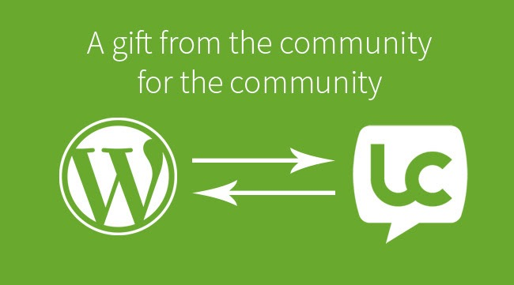
LiveCode + WP REST API
Webinar

Slide 2


The LiveCode Team
http://digitalpomegranate.com/livecode/

Slide 3

Outline of Today’s Webinar
WordPress
WordPress Data
WordPress Cloud
WP REST API
Plugins
Language Plugin
Visual Composer
LiveCode UI
Gravity Forms
Woo Commerce

Slide 4


Where to get the Code?
https://github.com/digitalpomegranate/livecode-wp-restapi

Slide 5

What is WordPress?
WordPress is a free and open-source content management system (CMS) based on PHP and MySQL. WordPress is installed on a web server. WordPress is based on web UI templates and plugins which add functionality to the core system,
WordPress itself can NOT be coded with LiveCode script, it requires PHP.

Slide 6
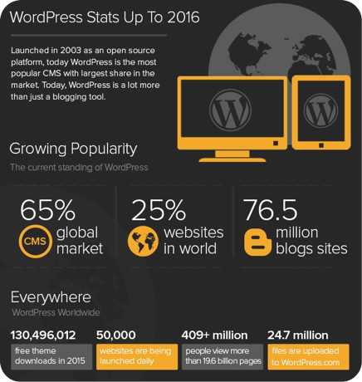
Why is WordPress so Popular?
Great Plugin Options
WordPress is cost-effective and flexible
WordPress is supported by worldwide community
Actually follows the MCV model
WordPress is easy to use!

Slide 7
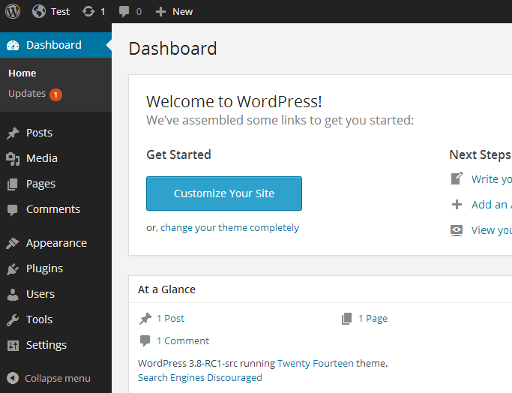
A Quick Look at the WordPress Admin
Pages
Post
Media
Appearance
Plugs
Users
Admin Tools

Slide 8
WordPress Page vs. Post
Post
Page
If you are using WordPress as a blog, then you will end up using posts for majority of your site’s content. Posts are content entries listed on a “blog page”. Posts encourage conversation. They have a built-in commenting feature that allows users to comment on a particular topic.
Pages are meant to be static “one-off” type content such as your about page, privacy policy, legal disclaimers, etc. While the WordPress database stores the published date of the page, pages are timeless entities.Unlike posts, pages are hierarchical by nature.

Slide 9
WordPress Custom Post Type & Fields
It’s pretty much universally agreed now that WordPress is more than just a blogging platform: It’s a CMS. But in my view what makes it a powerful CMS is the ability to create custom content and display that content in exactly the way you need to.
It’s important to remember that custom post types are not posts. They don’t have any direct relation to posts and you should think of them separately. Think of them more like tables in a DB. You can find a detailed explanation here: https://premium.wpmudev.org/blog/creating-content-custom-post-types/

Slide 10

WordPress Cloud Storage
A great idea is to use Wordpress as the data cloud storage for a mobile LiveCode App. It is the worlds most popular CMS for a reason. It’s easy a offers a perfect simple data storage for mobile Apps. It has security, user management, thousands of plugins that make it the perfect cloud storage.

Slide 11

WordPress REST API
http://v2.wp-api.org/

Slide 12
WP REST API Basic Concepts
This plugin provides an easy to use REST API, available via HTTP. Grab your site’s data in simple JSON format, including users, posts, taxonomies and more. Retrieving or updating data is as simple as sending a HTTP request.
Want to get your site’s posts? Simply send a GET request to /wp-json/wp/v2/posts. Update user with ID 4? Send a POST request to /wp-json/wp/v2/users/4. Get all posts with the search term “awesome”? GET /wp-json/wp/v2/posts?search=awesome. It’s that easy.
The API exposes a simple yet easy interface to WP Query, the posts API, post meta API, users API, revisions API and many more. Chances are, if you can do it with WordPress, WP API will let you do it.

Slide 13
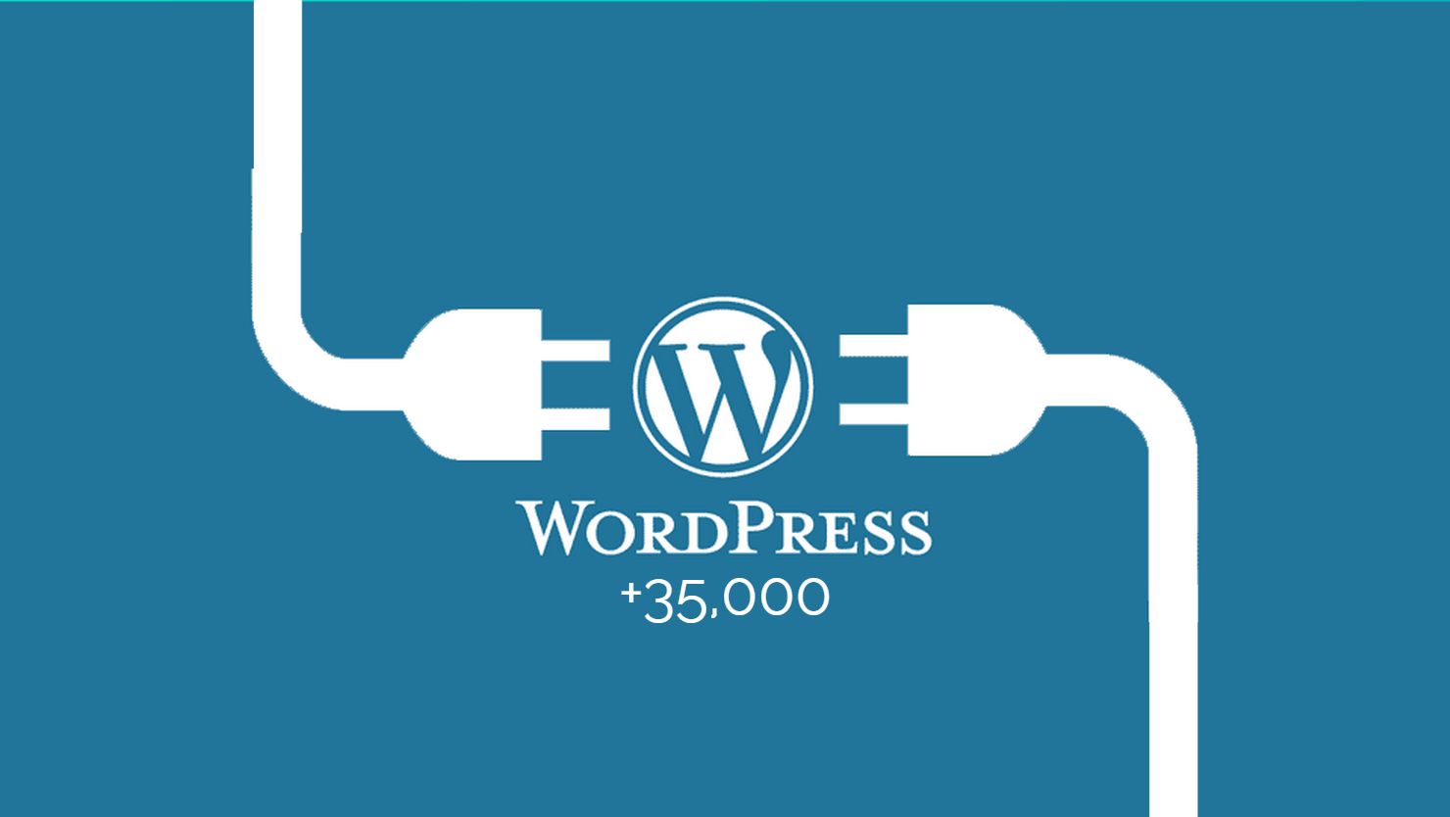
WordPress Plugins

Slide 14
WordPress Plugins
A plugin is a piece of software containing a group of functions that can be added to a WordPress website. They can extend functionality or add new features to your WordPress websites. WordPress plugins are written in the PHP programming language and integrate seamlessly with WordPress.
Plugins makes it easy for users to add features to their website without knowing a single line of code.

Slide 15
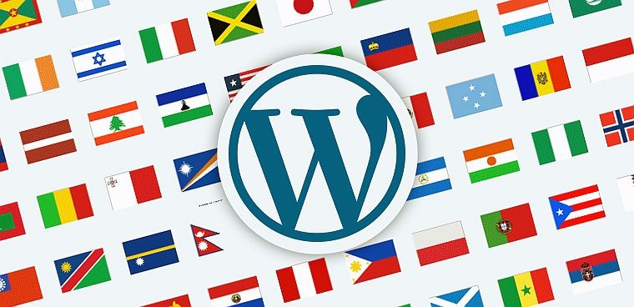
Language Plugin: QTranslate X
https://wordpress.org/plugins/qtranslate-x/installation/

Slide 16

WP Plugin: Visual Component

Slide 17
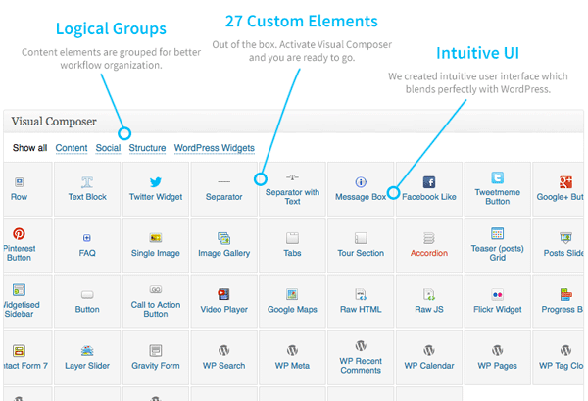

Slide 18
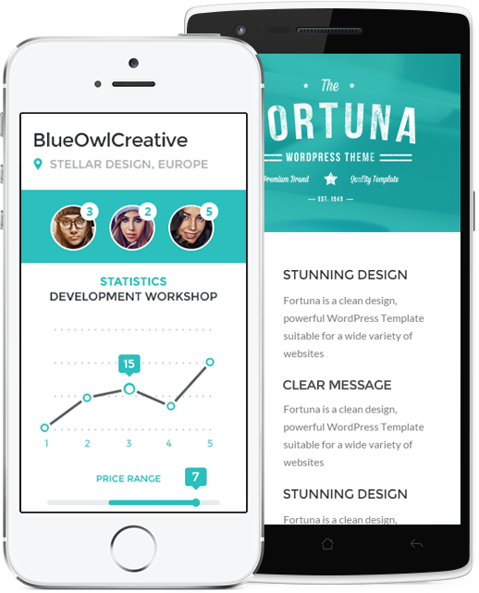

LiveCode Community Project
Form Builder Object for LiveCode Apps
To create a LiveCode objects that would

Slide 19

WP Plugin: Gravity Forms

Slide 20
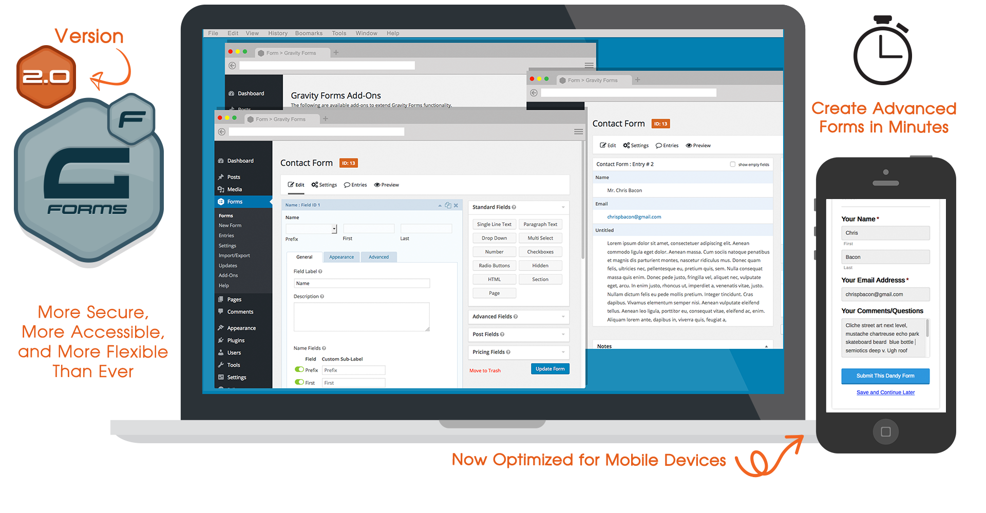
Gravity Forms: Complex Control Plugin

Slide 21
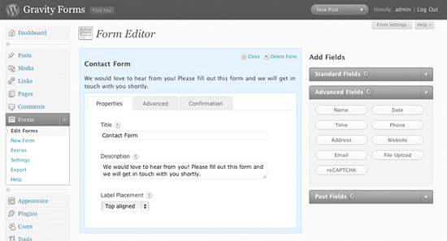
Gravity Forms: Form Builder

Slide 22
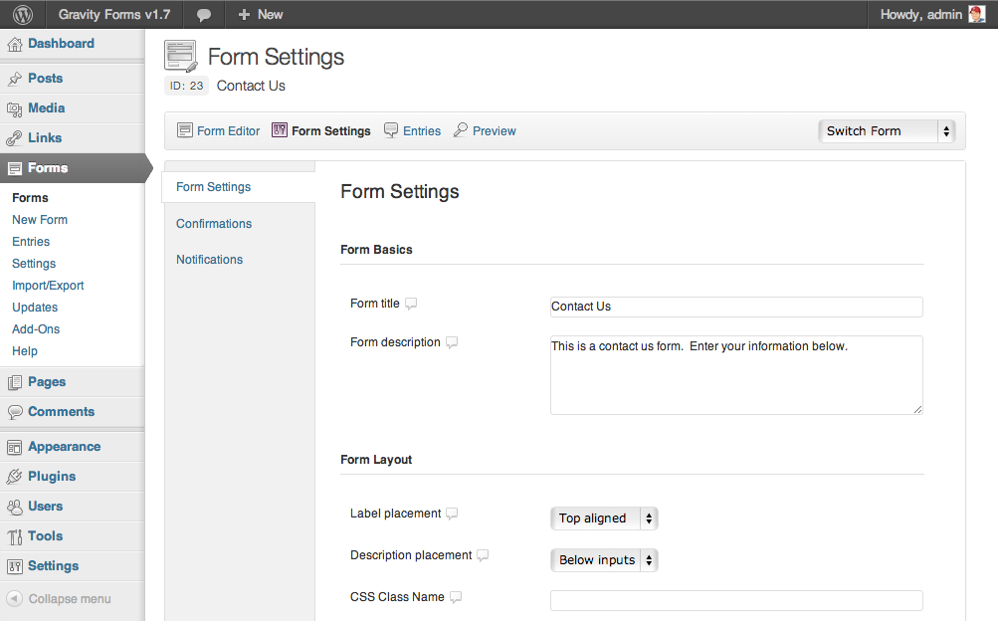
Gravity Forms: Form Settings

Slide 23
Gravity Forms: Understanding the Eco System
Form Designer
Form UI
Form Data
Form Communications

Slide 24
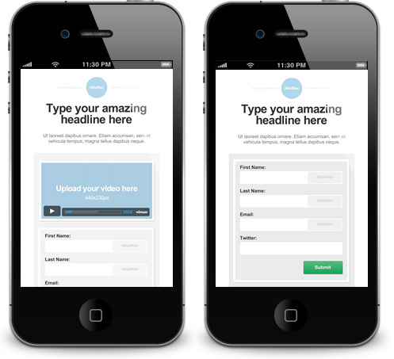
LiveCode Community Project
Form Builder Object for LiveCode Apps
To create a LiveCode objects that would

Slide 25

eCommerce: Huge Potential for LiveCode

Slide 26
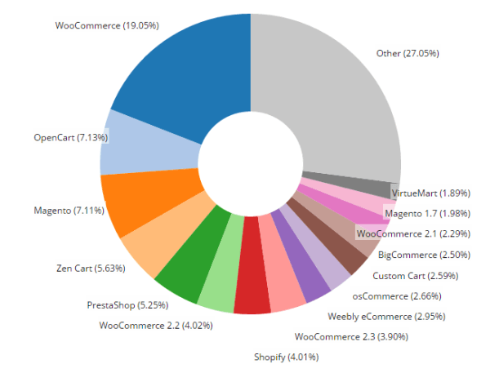
29.26%

Slide 27

Woo Commerce Requires SSL
It is very important that you get SSL on your WP website for eCommerce. In fact, the Woo REST API requires it!!
https://www.youtube.com/watch?v=AS-9gMFBHfI

Slide 28
LiveCode Marketplace
Showcase LiveCode
Focus on Business Development
Spotlight on Successful Apps
List of useful Open Source Components
Directory of Firms
Place to submit a project and get bids

